Slide 1
General Districting Considerations
Legal Requirements
Geography
Neighborhoods
Physical Layout
School Districts and Other Areas
Political Participation
Voter Registration
Voter Turnout
Ethnic Shares
Demographic Characteristics
Population by Ethnicity
Voting Age Population by Ethnicity
Citizen Voting Age by Ethnicity
Socio-Economic Characteristics
Income
Home Ownership
Age of Housing
Length of Residence
Public Input

Slide 2
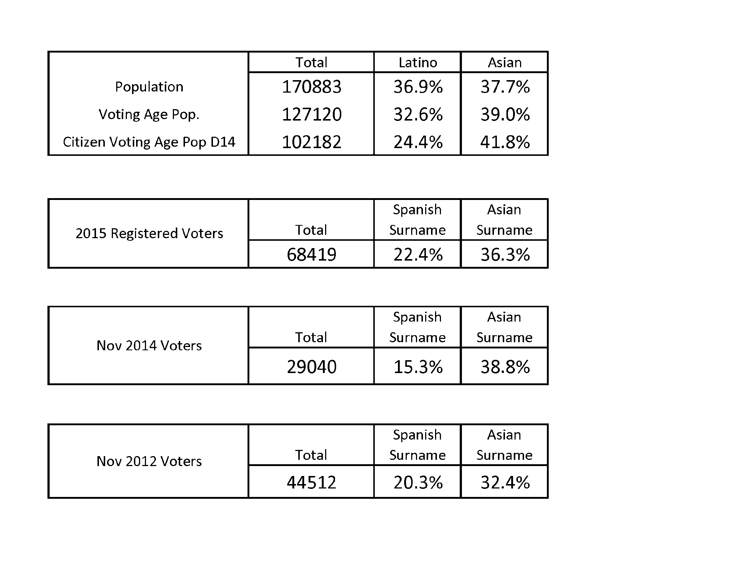
Demographic Data
Notes:
Modify to include 2014 CVAP

Slide 3
Outreach Summary
Website
Mailings (Water Bill Inserts)
Press Releases
TV Segment
Social Media (Facebook, twitter)
Flyer distribution on public counters and at public meetings
Listings on City's Events Calendar
Email blasts to subscriber database
Emails to local community groups and residents
Individual and community meetings

Slide 4
Meeting Summary
Council Study Session (11/24/2015)
Round 1
11 Personal and Small Group Meetings (11/30/2015 - 12/4/2015)
3 Community Meetings
GG Sports & Recreation Center 12/9/15
Courtyard Center 12/12/15
Kiwanisland 12/16/15
Council Public Hearing (1/26/2016)
Round 2
9 Personal and Small Group Meetings (1/28/2016 – 2/2/2016)
4 Community Meetings
Buena Clinton Family Resource Center 3/2/16
Community Meeting Center 3/5/16
GGUSD Maintenance Facility 3/9/16
GG Sports & Recreation Center 3/12/16
Council Presentation (3/22/2016)
Council Public Hearings (4/12/2016, 4/26/2016)

Slide 5
Maps Summary
3 Five District Consultant Sample Maps
4 Six District Consultant Sample Maps (Based on First Round Public Input)
2 Six District Public Submissions
3 Six District Alternatives (Based on Second Round Public Input)
Final Consultant Sample 6E
Public Submission 1 - Kim Nguyen
Public Submission 2D – Andrew Kanzler

Slide 6
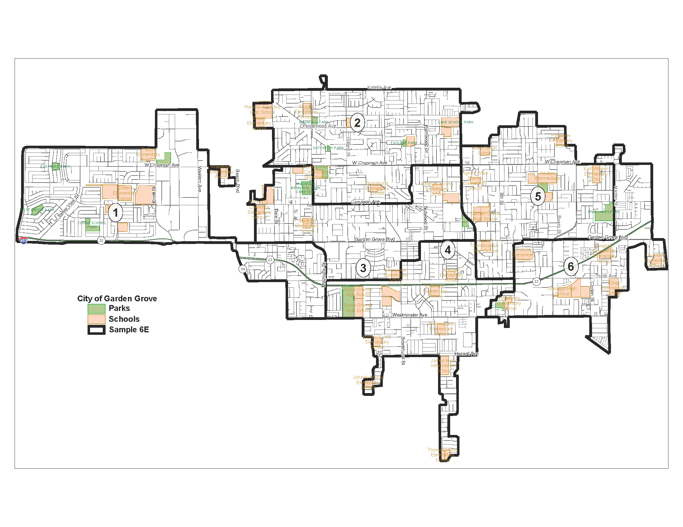
Consultant Sample 6E

Slide 7
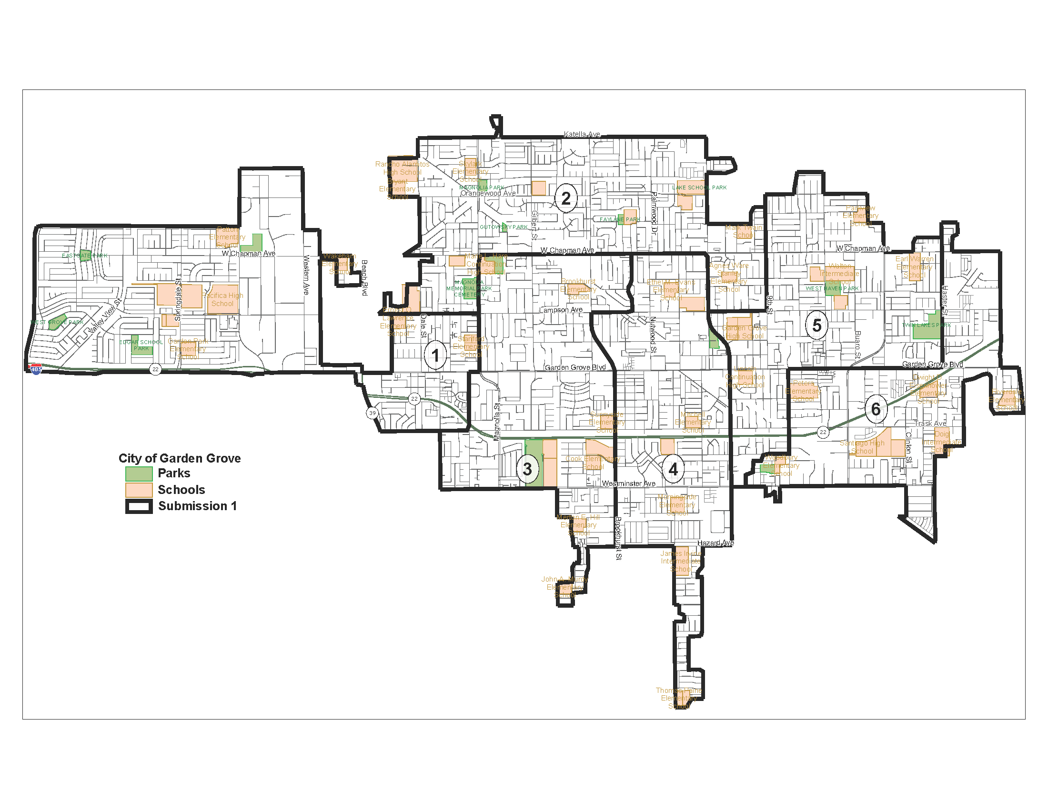
Public Submission 1

Slide 8
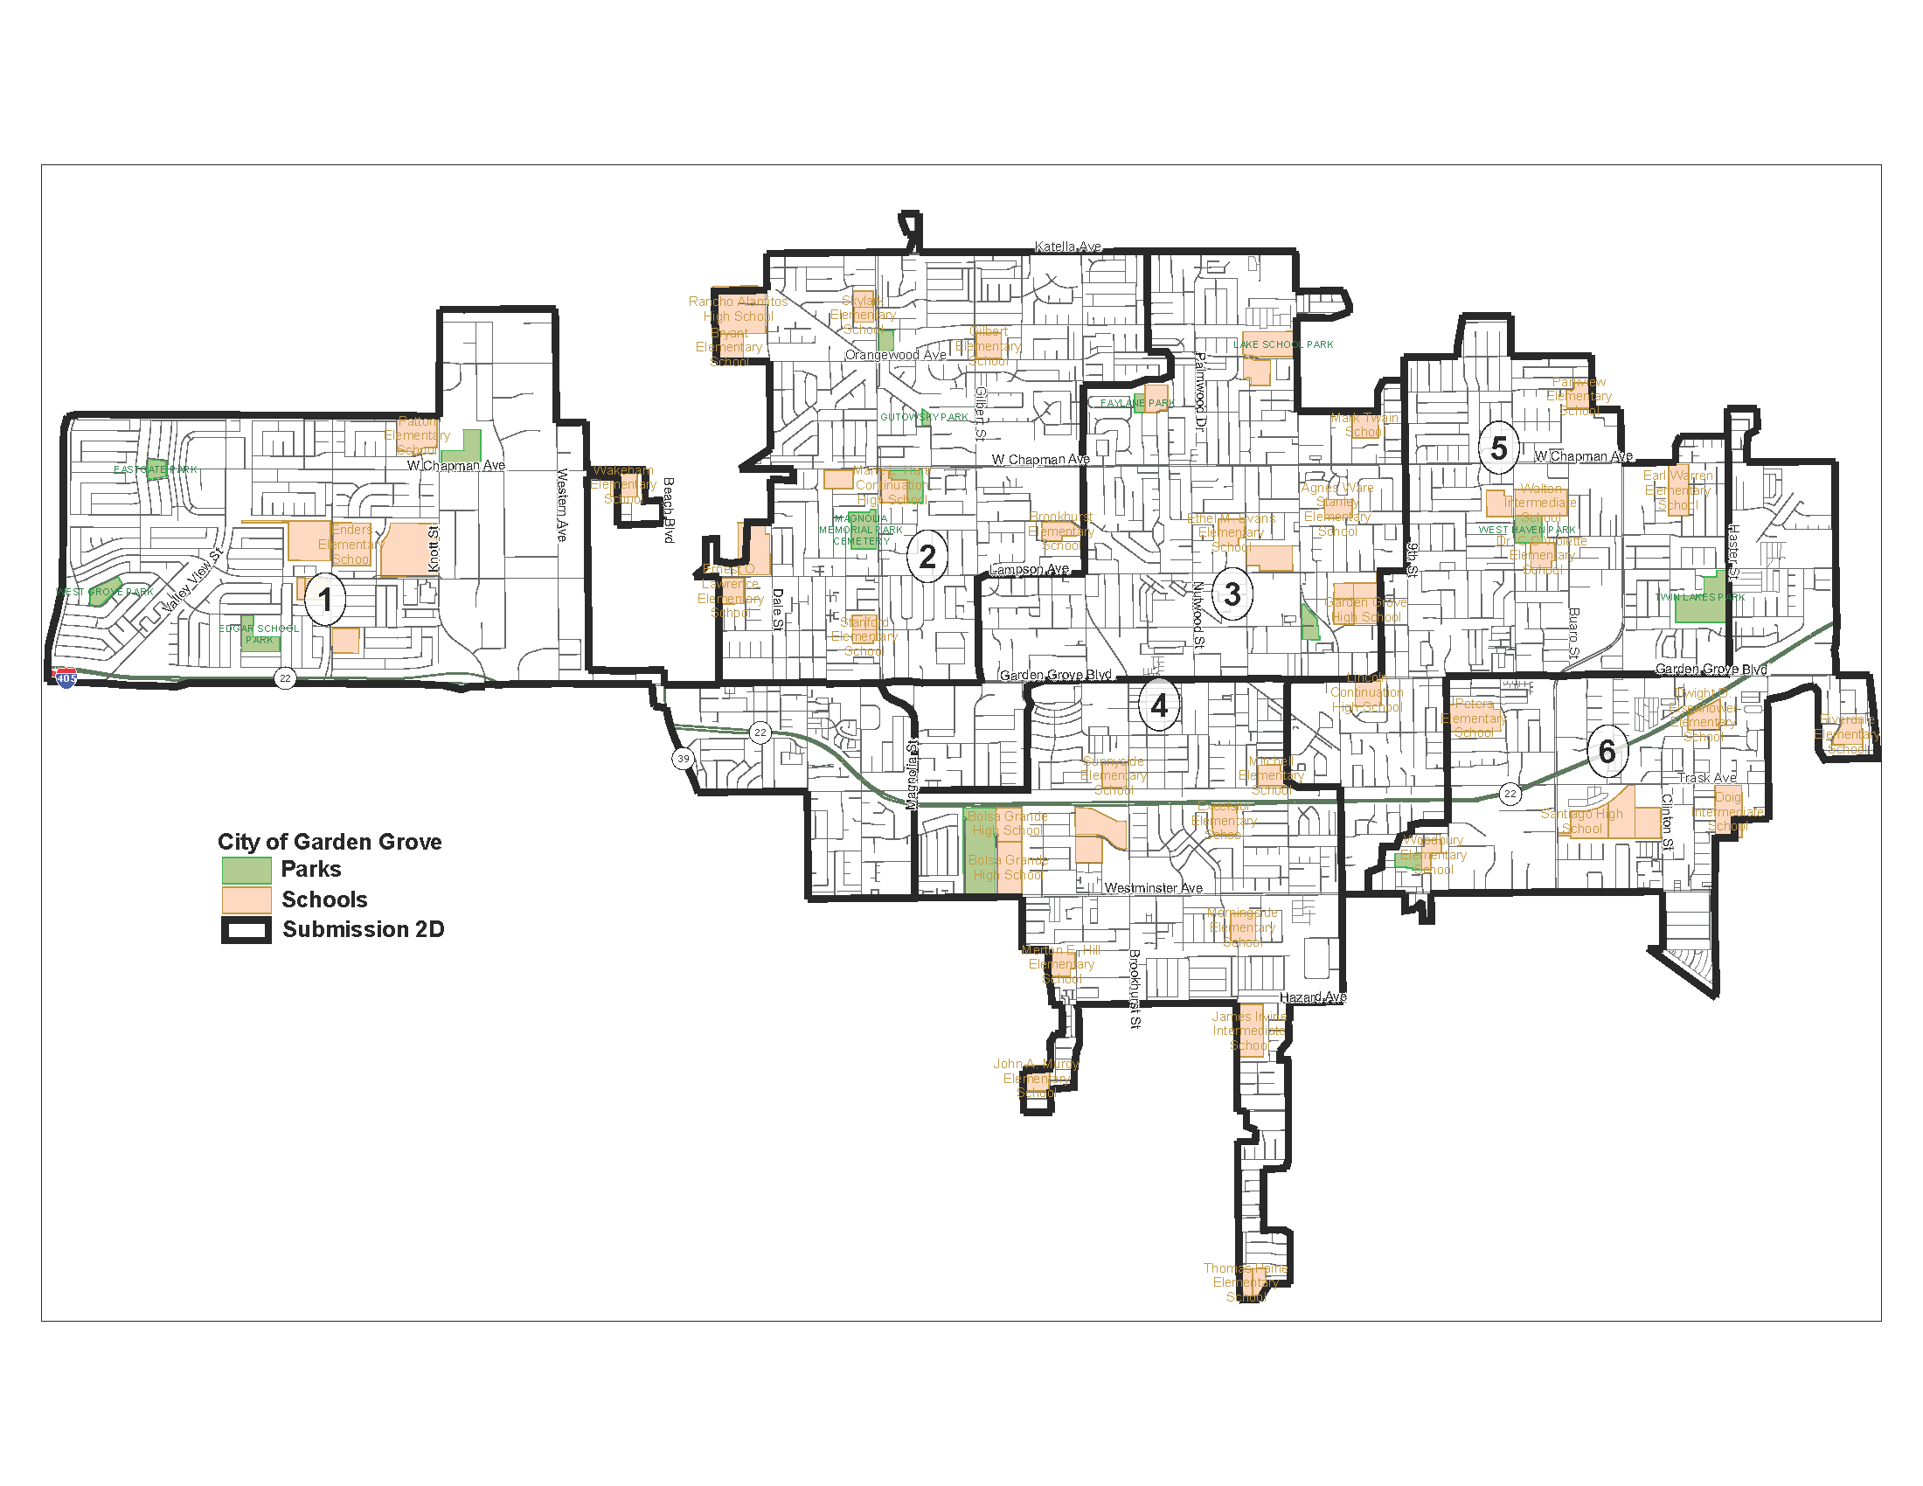
Public Submission 2D

Slide 9
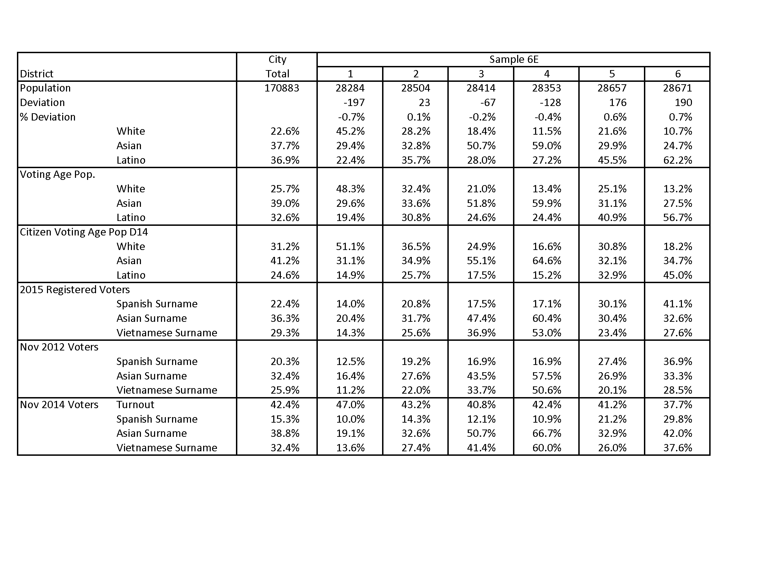
Consultant Sample 6E Table

Slide 10
Public Submission 1 Table

Slide 11
Public Submission 2D Table

